Slide 1
Birds identification course
Semidesert birds

Slide 2
Content
European bee-eater
Blue-cheeked bee-eater
Eurasian roller
Eurasian hoopoe
Training in identification

Slide 3
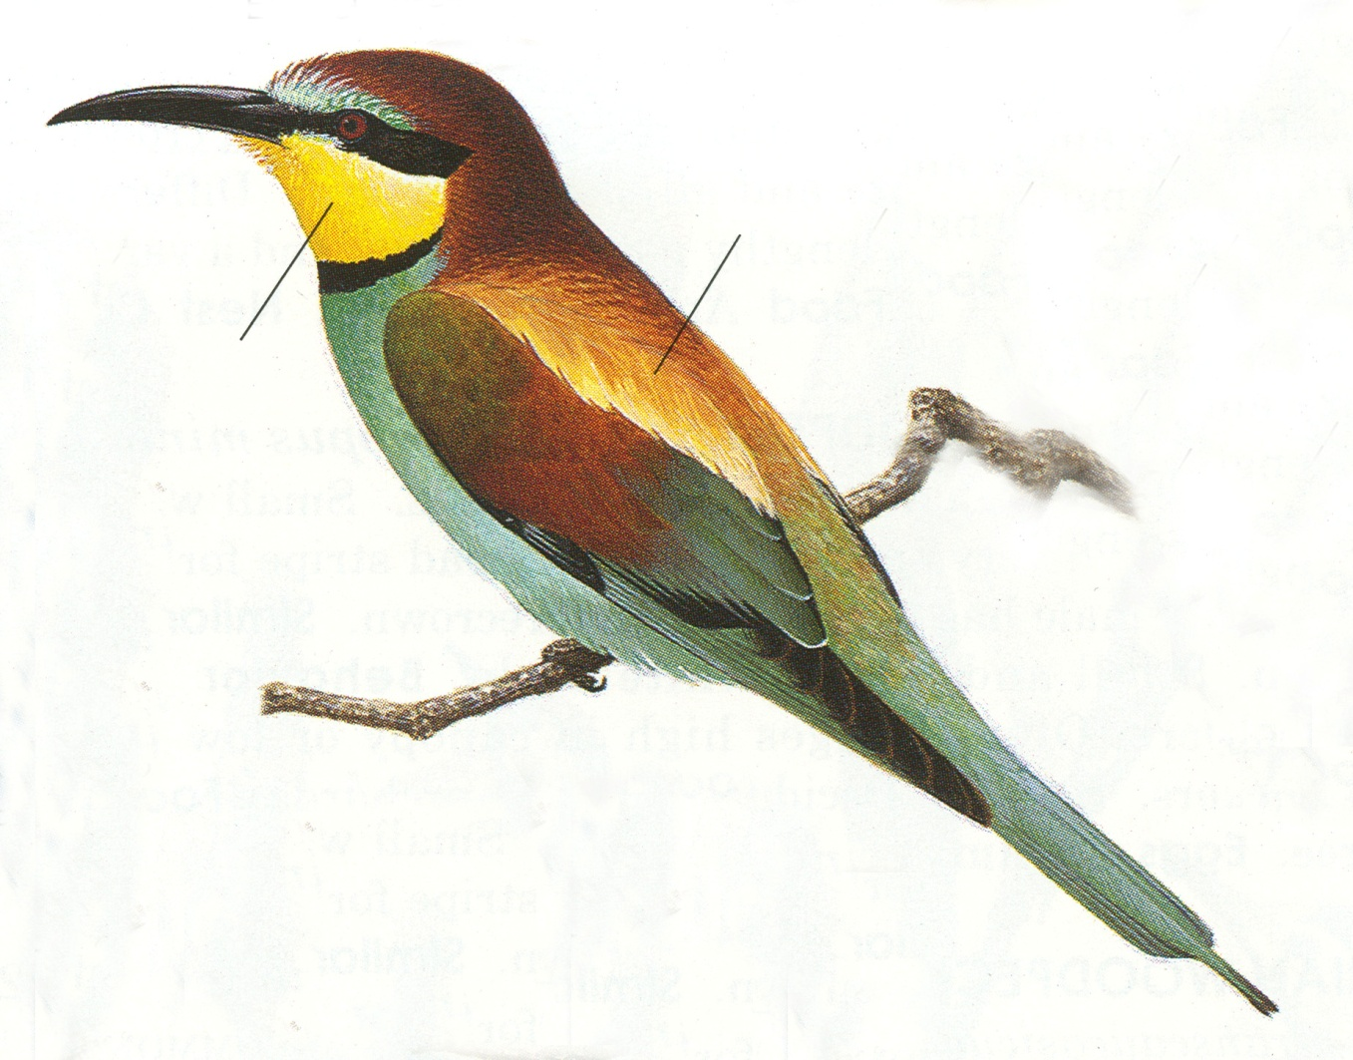
EUROPEAN BEE-EATER
Merops apiaster Золотистая Щурка Ոսկեգույն մեղվակեր
Black and decurved bill
Yellow throat
Brown-red and yellow pattern on upperparts
The central feathers of the tail are longer than the rest

Slide 4
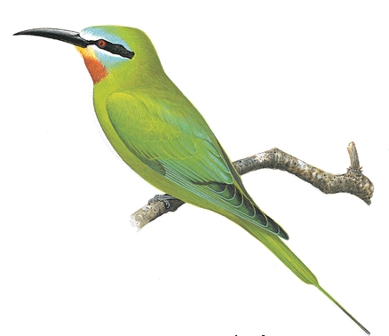
BLUE-CHEEKED BEE-EATER
Merops persicus Зеленая Щурка Կանաչ մեղվակեր
Overall green
Face with blue, black and white
Reddish throat
Yellow chin
The central feathers of the tail are much longer than the rest

Slide 5
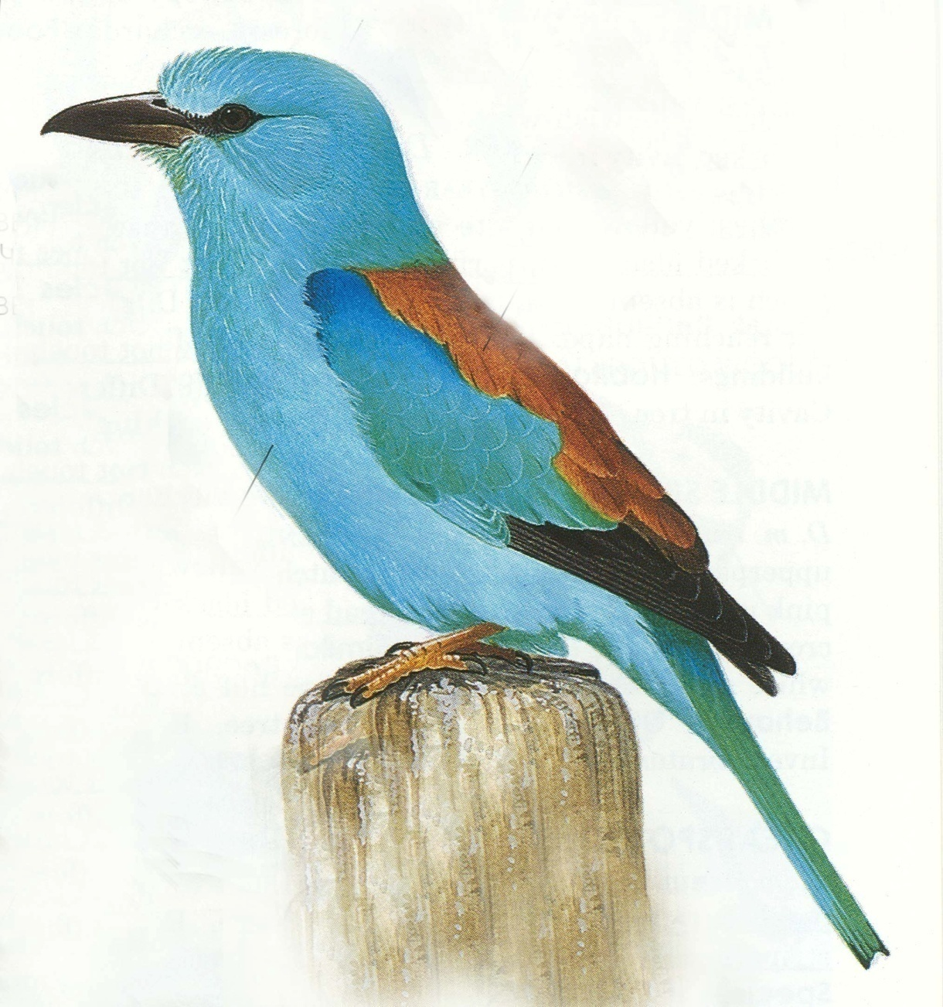
EURASIAN ROLLER
Coracias garrulus Сизоворонка Ներկարար
Black bill and eye.
Bright blue plumage
Red-brown back
Black flight feathers

Slide 6
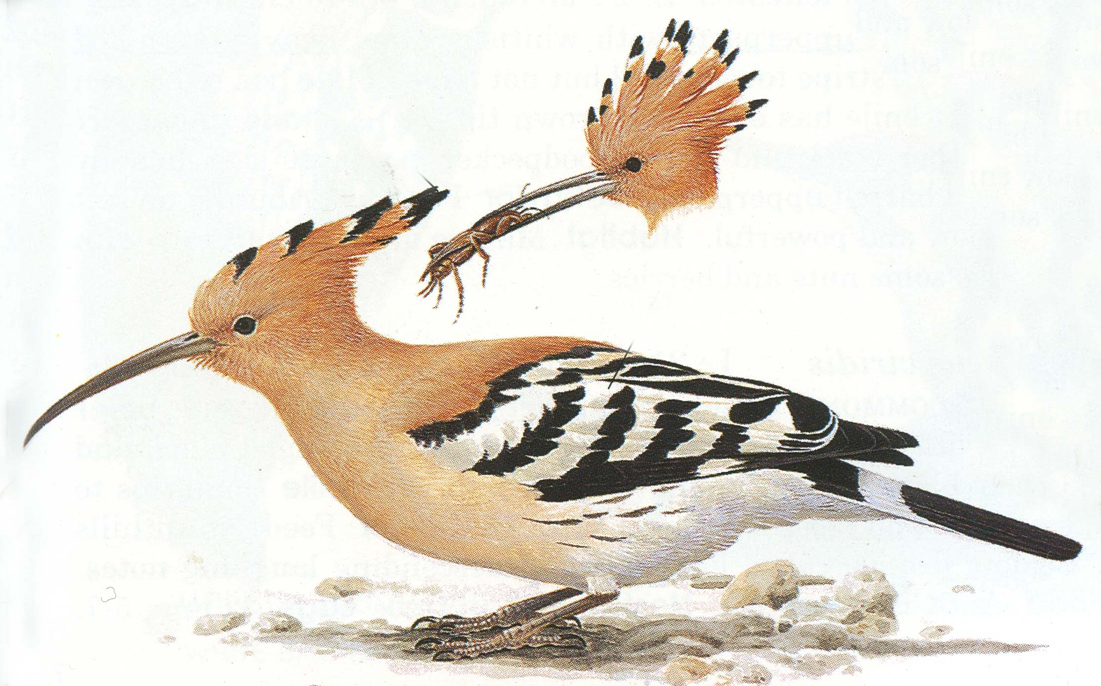
EURASIAN HOOPOE
Upupa epops Удод Հոպոպ
Orange crest, with dark tips.
Long decurved bill
Flight feathers and the tail with black and white barring.
Plumage yellowish-orange.

Slide 7
TRAINING 1
Click to begin the training and wait: slides will change automatically each 10 seconds.
During that time you have to write their names on the training sheet.
After finishing the training you can check yourself using answers (number of slide and name of bird species) provided at the end.

Slide 8
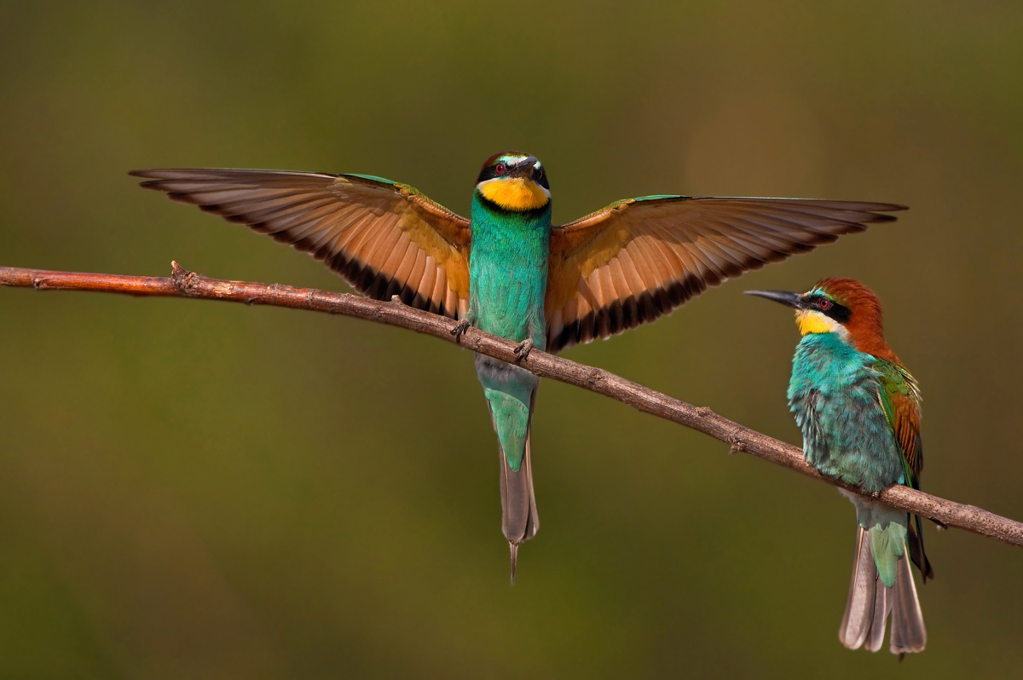

Slide 9
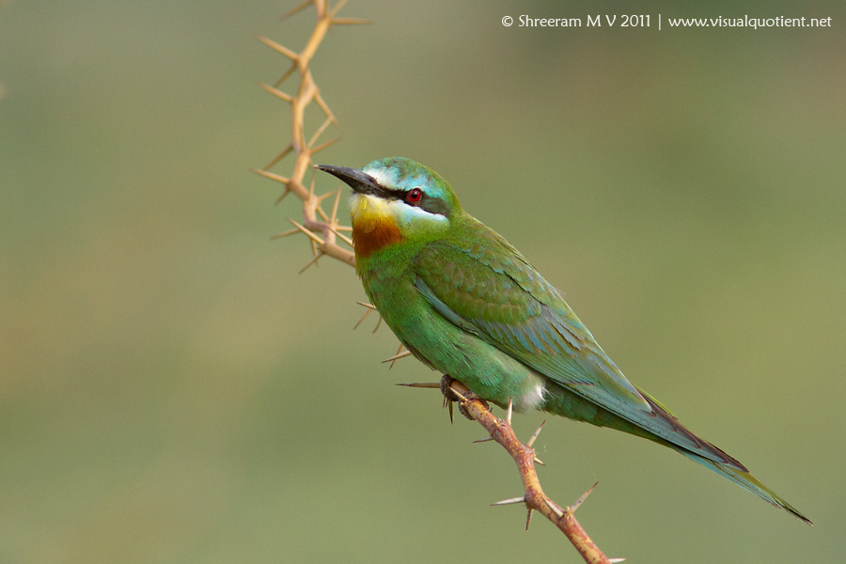

Slide 10
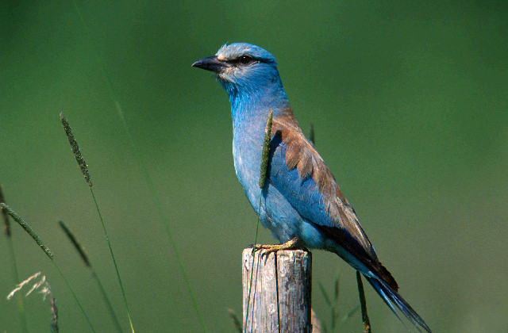

Slide 11
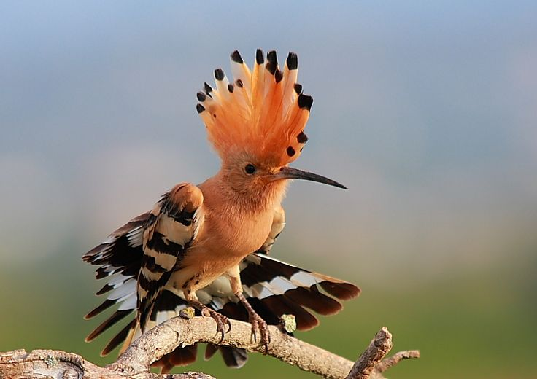

Slide 12
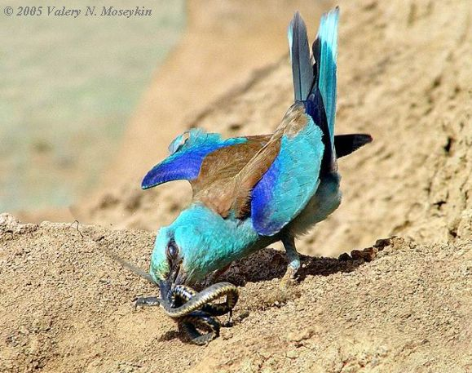

Slide 13
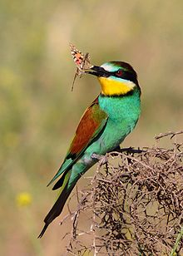

Slide 14
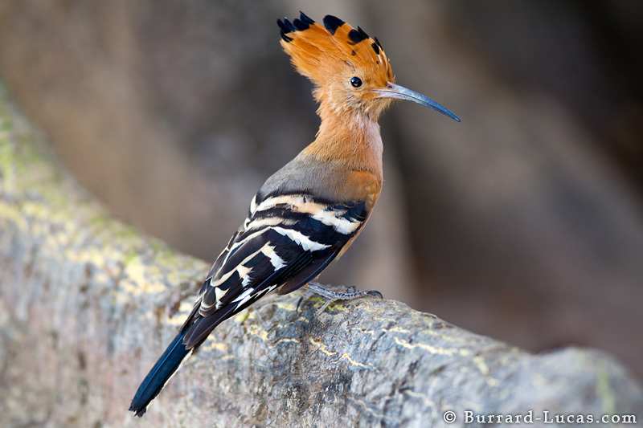

Slide 15
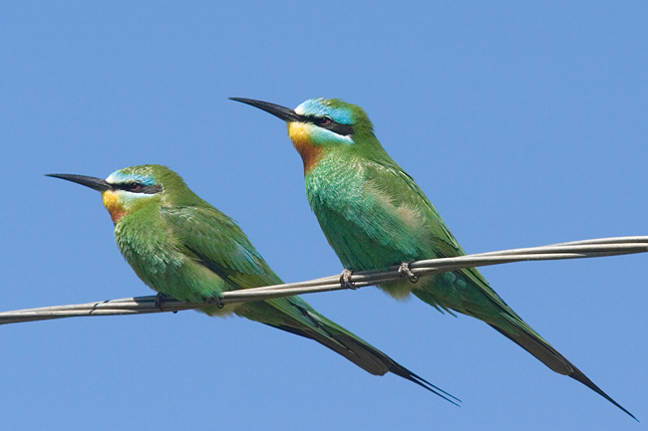

Slide 16
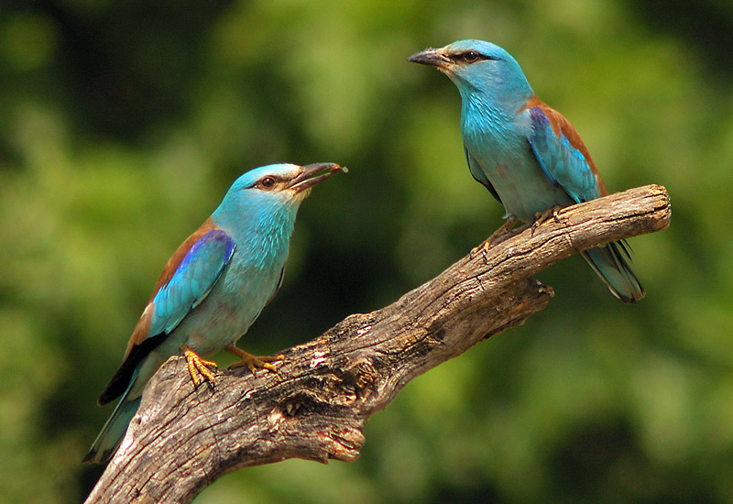

Slide 17
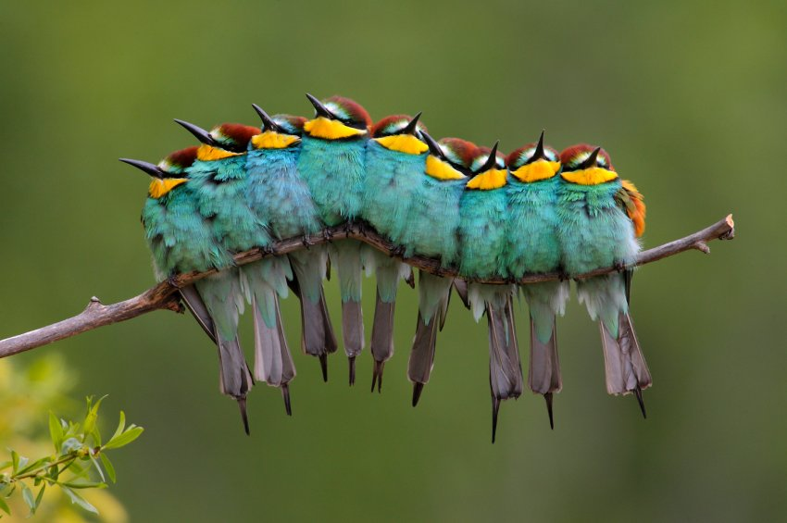

Slide 18
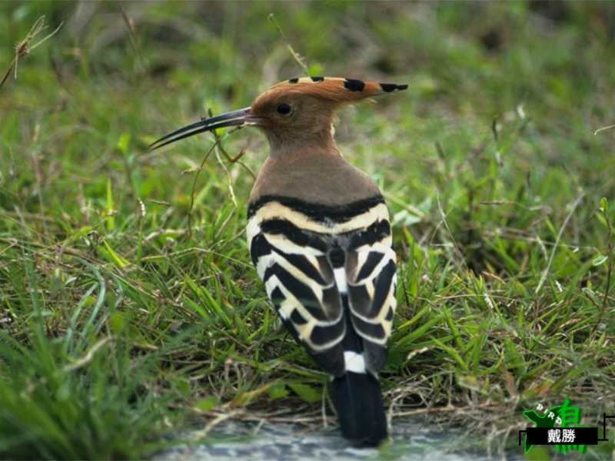

Slide 19
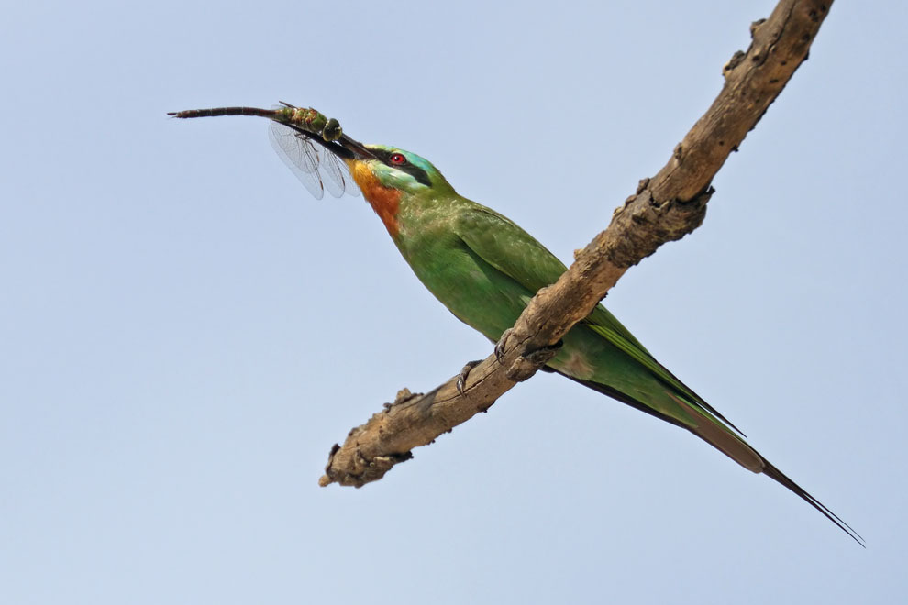

Slide 20
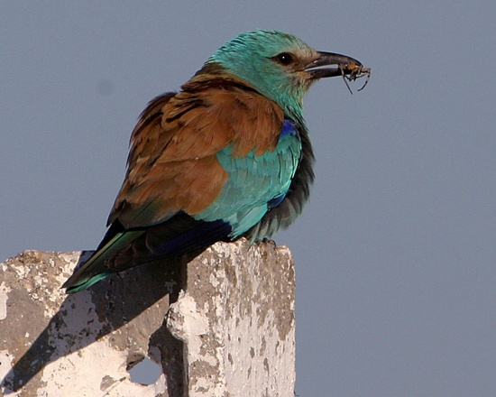

Slide 21
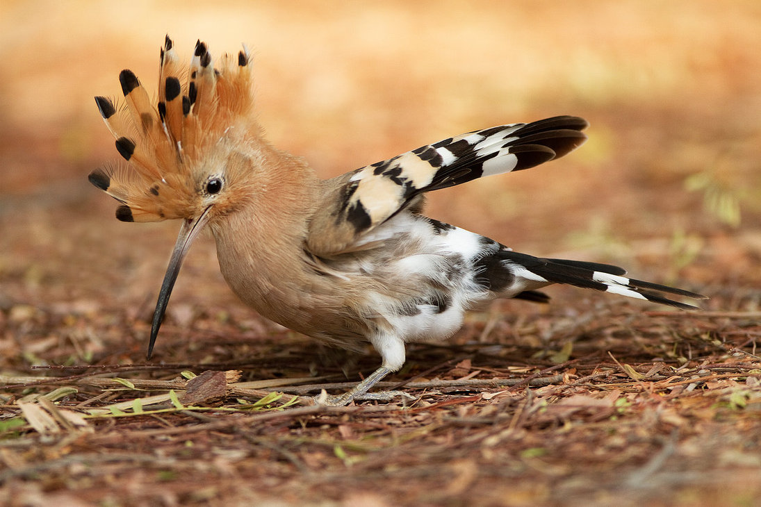

Slide 22
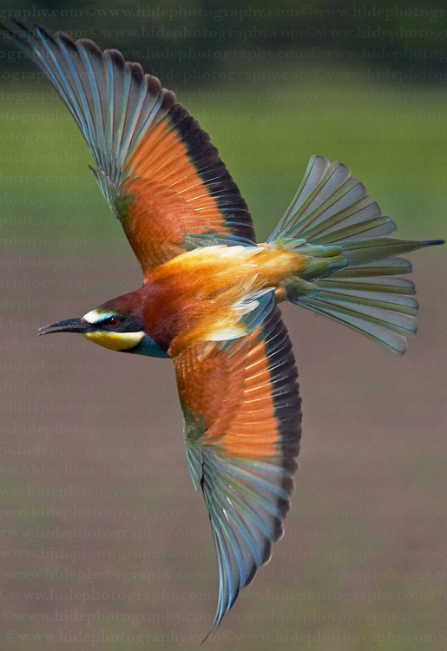

Slide 23
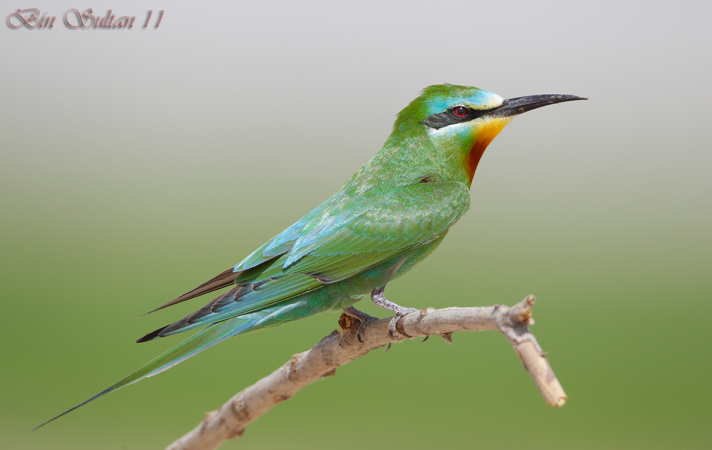

Slide 24
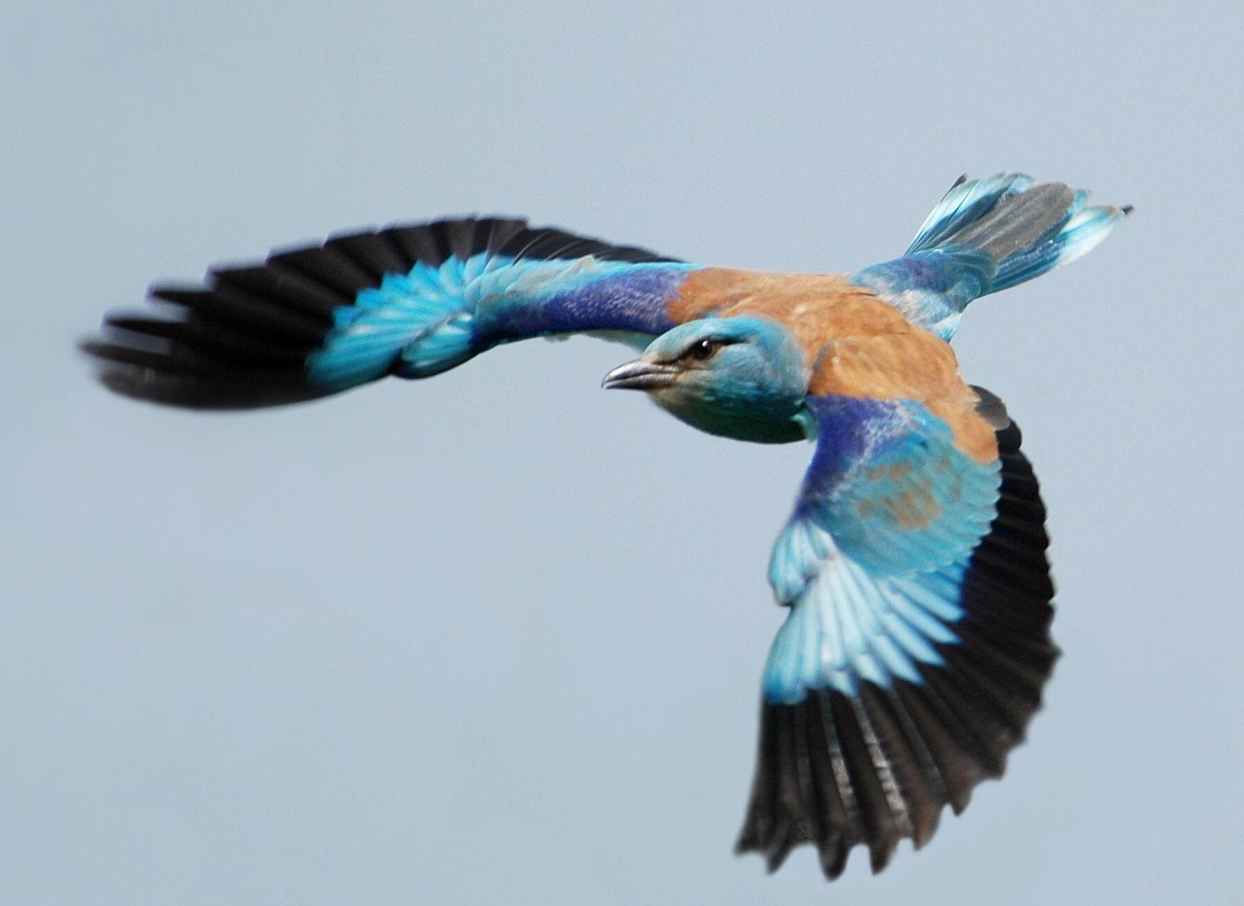

Slide 25
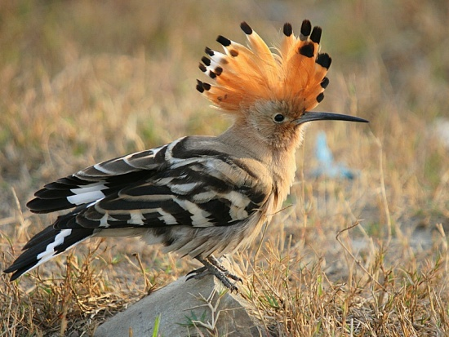

Slide 26
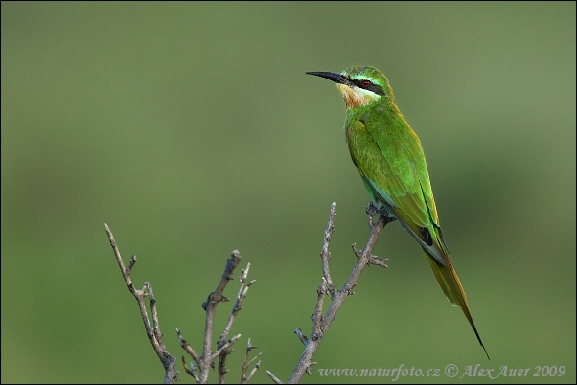

Slide 27
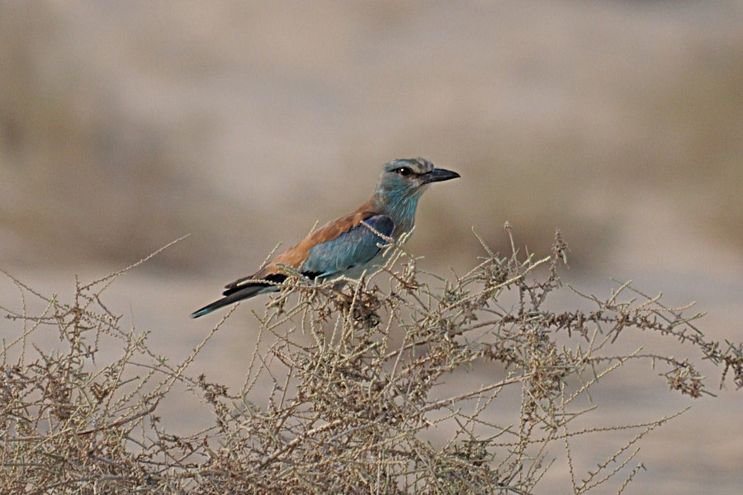

Slide 28
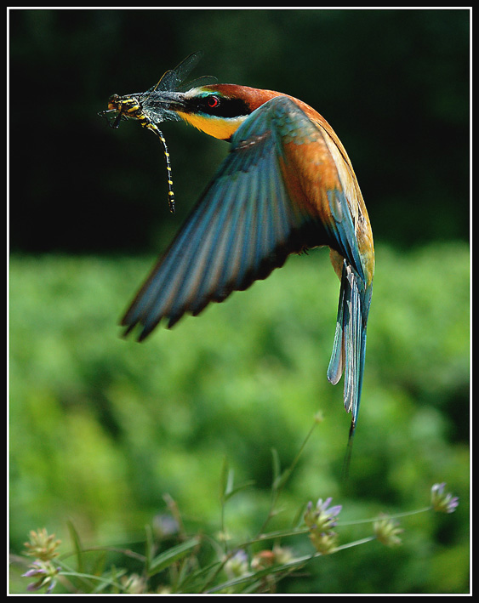

Slide 29
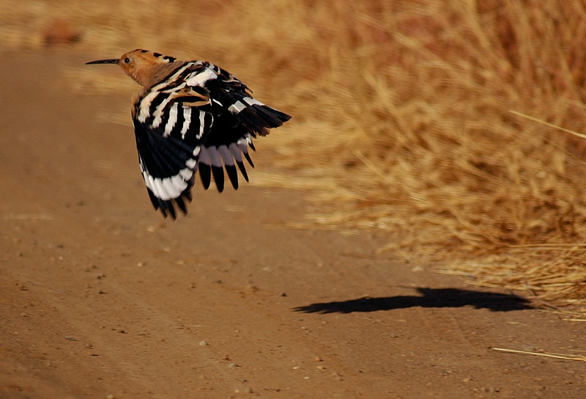

Slide 30
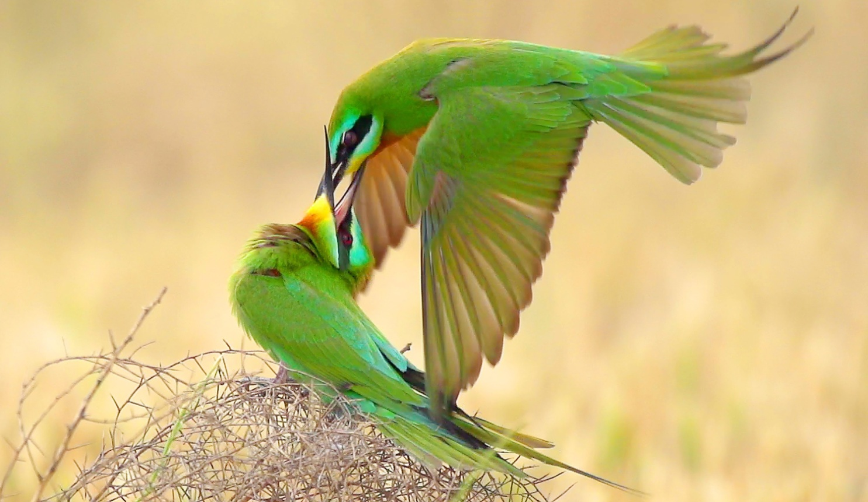

Slide 31
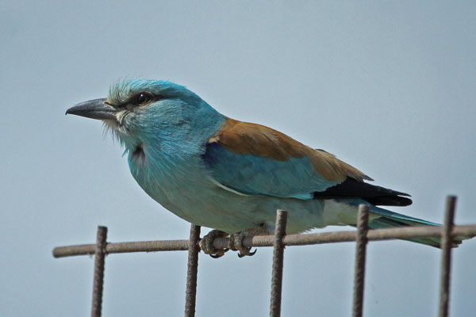

Slide 32
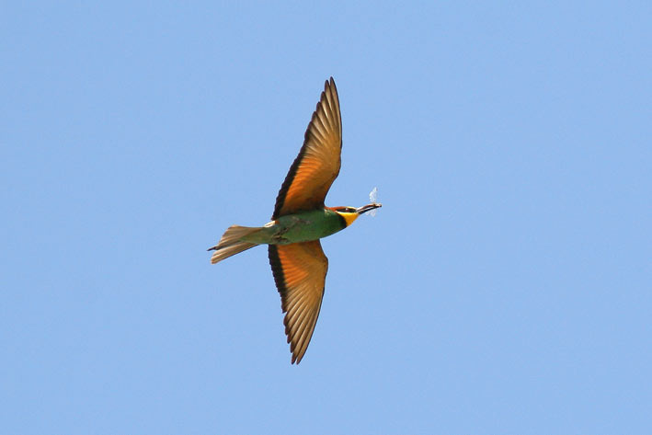

Slide 33
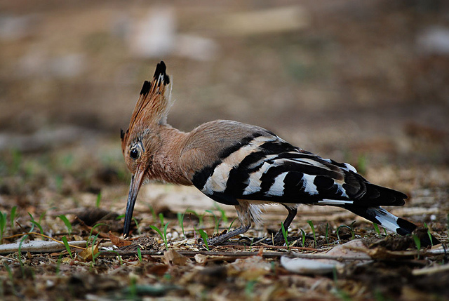

Slide 34
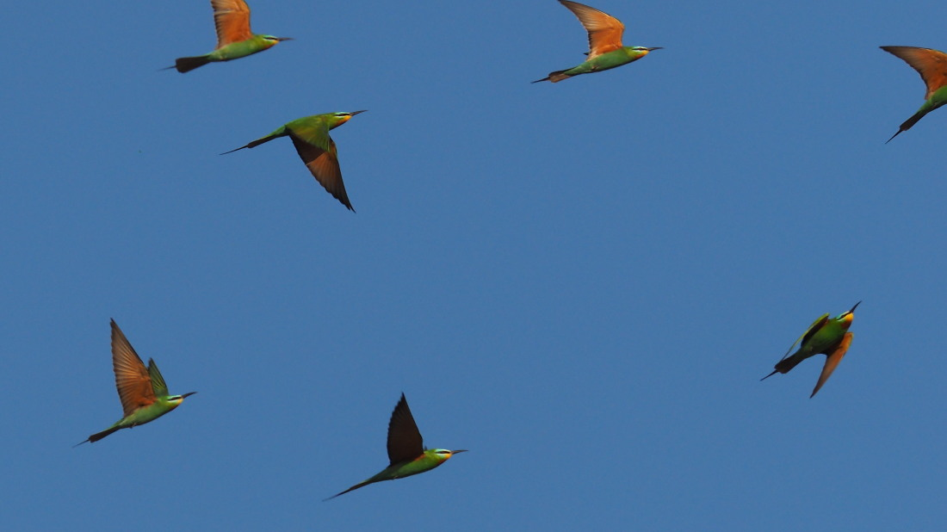

Slide 35
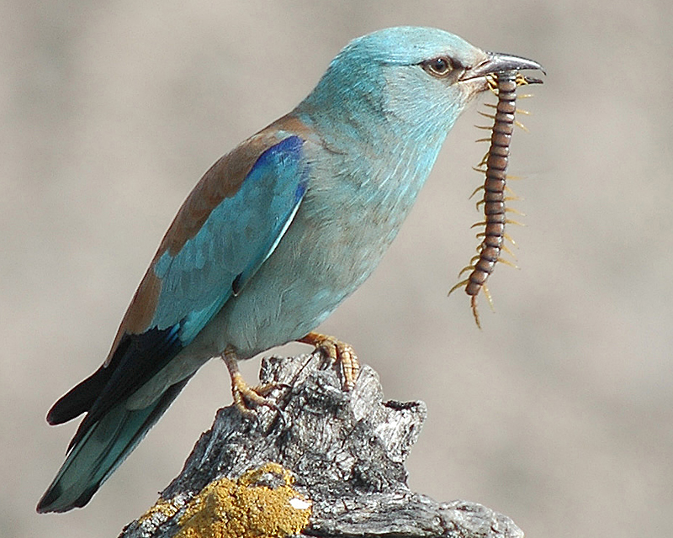

Slide 36
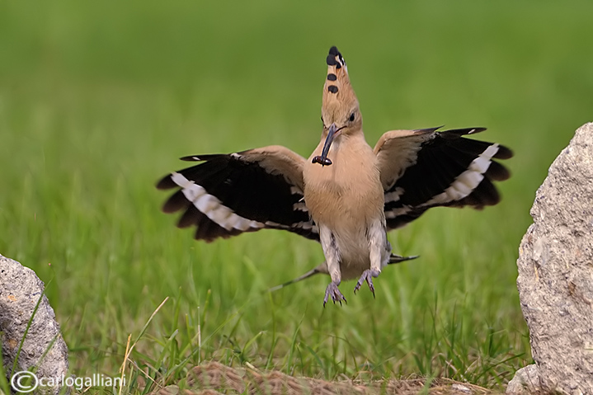

Slide 37
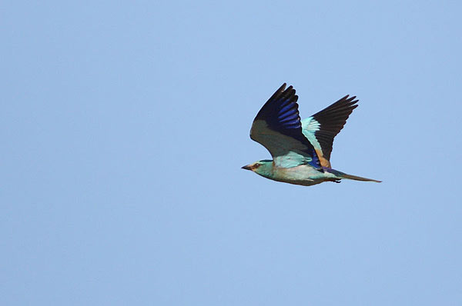

Slide 38
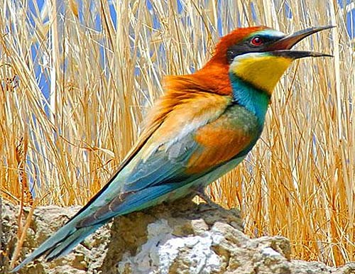

Slide 39
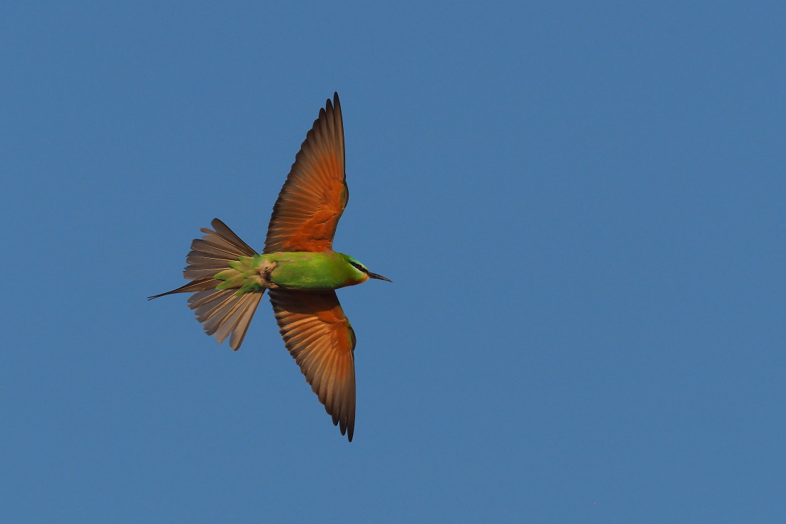

Slide 40
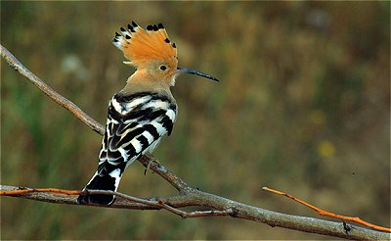

Slide 41
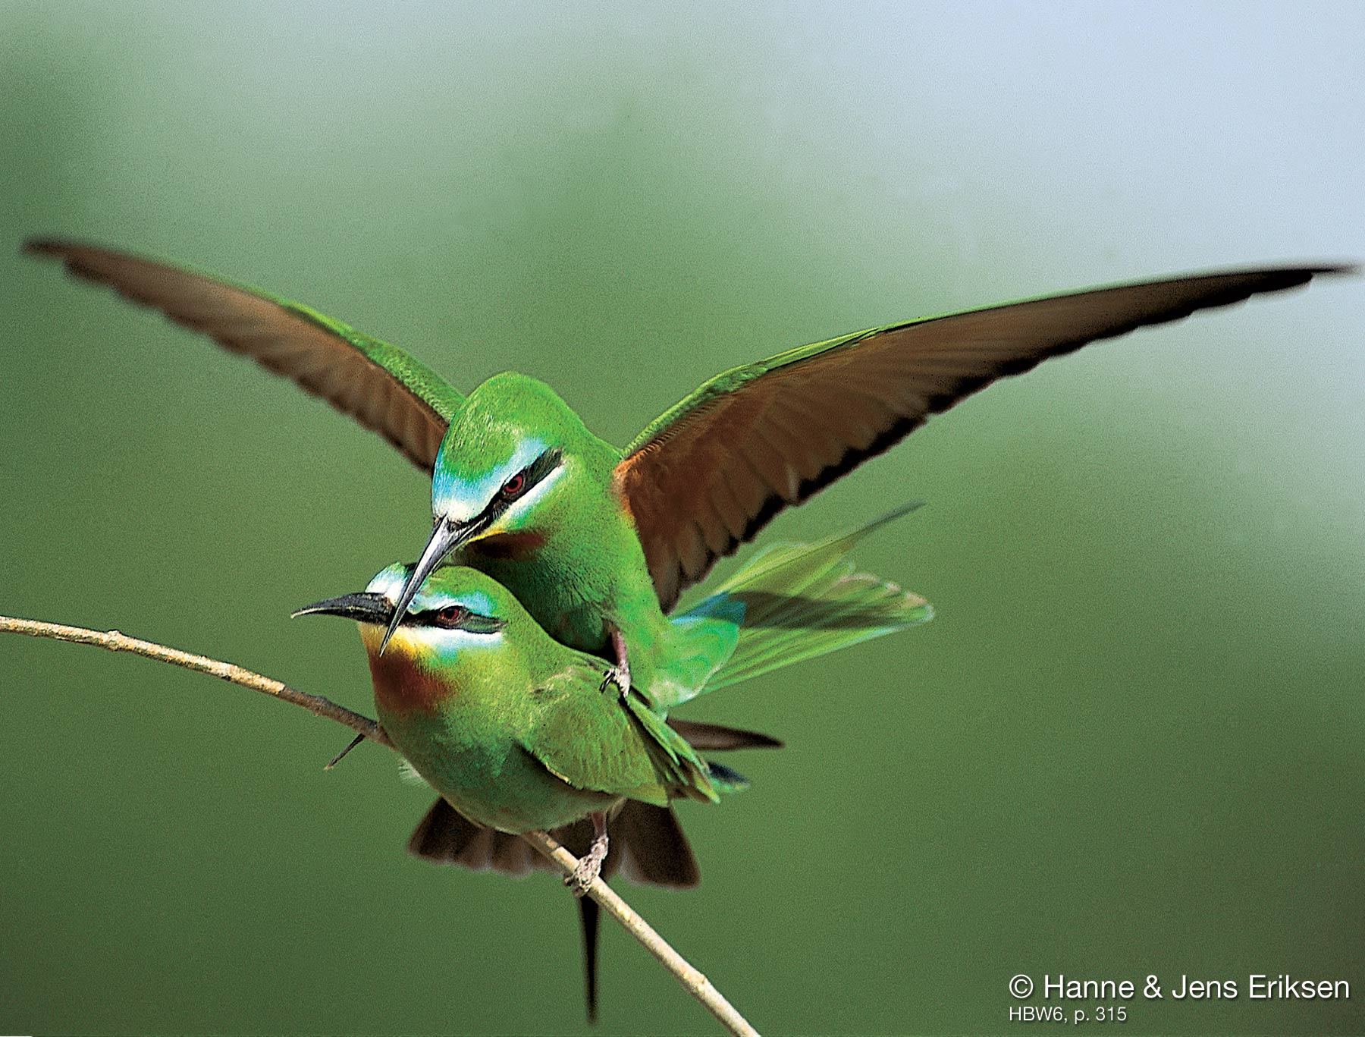

Slide 42
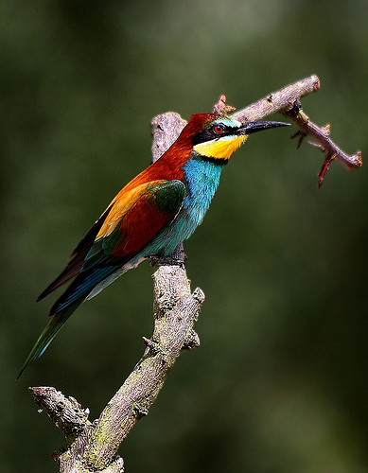

Slide 43
Answers
8. European Bee-eater
9. Blue-cheeked Bee-eater
10. Eurasian Roller
11. Eurasian Hoopoe
12. Eurasian Roller
13. European Bee-eater
14. Eurasian Hoopoe
15. Blue-cheeked Bee-eater
16. Eurasian Roller
17. European Bee-eater
18. Eurasian Hoopoe
19. Blue-cheeked Bee-eater
20. Eurasian Roller
21. Eurasian Hoopoe
22. European Bee-eater
23. Blue-cheeked Bee-eater
24. Eurasian Roller
25. Eurasian Hoopoe
26. Blue-cheeked Bee-eater
27. Eurasian Roller
28. European Bee-eater
29. Eurasian Hoopoe
30. Blue-cheeked Bee-eater
31. Eurasian Roller
32. European Bee-eater
33. Eurasian Hoopoe
34. Blue-cheeked Bee-eater
35. Eurasian Roller
36. Eurasian Hoopoe
37. Eurasian Roller
38. European Bee-eater
39. Blue-cheeked Bee-eater
40. Eurasian Hoopoe
41. Blue-cheeked Bee-eater
42. European Bee-eater

Slide 44
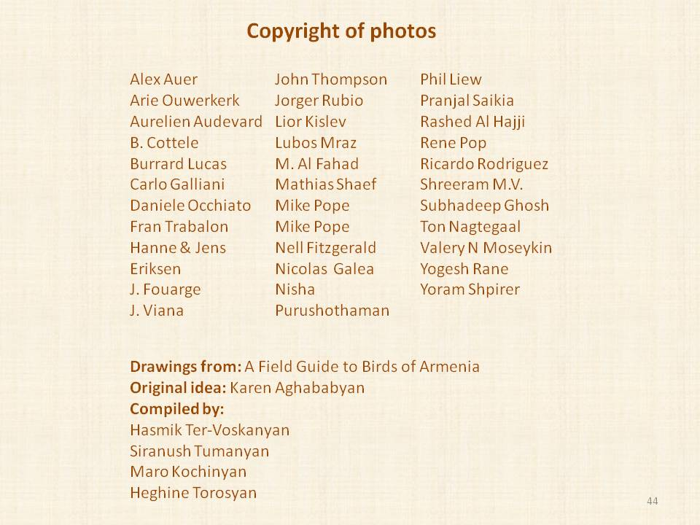

Slide 45
THANK YOU FOR YOUR ATTENTION

